Slide 1
R

Slide 2
Why R?
It’s free.
You can add lots of capabilities. For free.
  There are “packages” online
  You can write your own functions relatively easily
Command line or GUI
Bandwagon
Communication across disciplines
It looks great on your resume

Slide 3
R Weirdness
Command line – it’s a different way of thinking
You can have multiple different objects (vectors, matrices, data frames) all floating around in your workspace. You have to keep things straight
It’s easy to make mistakes, and R won’t necessarily tell you
R error messages are obscure
Notes:
R is a command based language
When you want to run a command, you use parentheses. If you just type the command, it will tell you the coding behind it
You have to steer R toward where you want it to go. You set a working directly so it knows where to read in files. This allows you to read in and save files without writing the full file path, but alternatively, you can just write out the file path.
One thing that may be different than what you are used to is that you can have multiple objects in your working environment. These may be data frames, or vectors, or other things. If you want to see everything you have in your working environment, you can list it out.

Slide 4
R Advantages
R can easily handle very large datasets (113 million rows and counting)
There is more functionality in R than there is in other software (social network packages, scaling, etc.)
You can’t beat the visualization of data

Slide 9
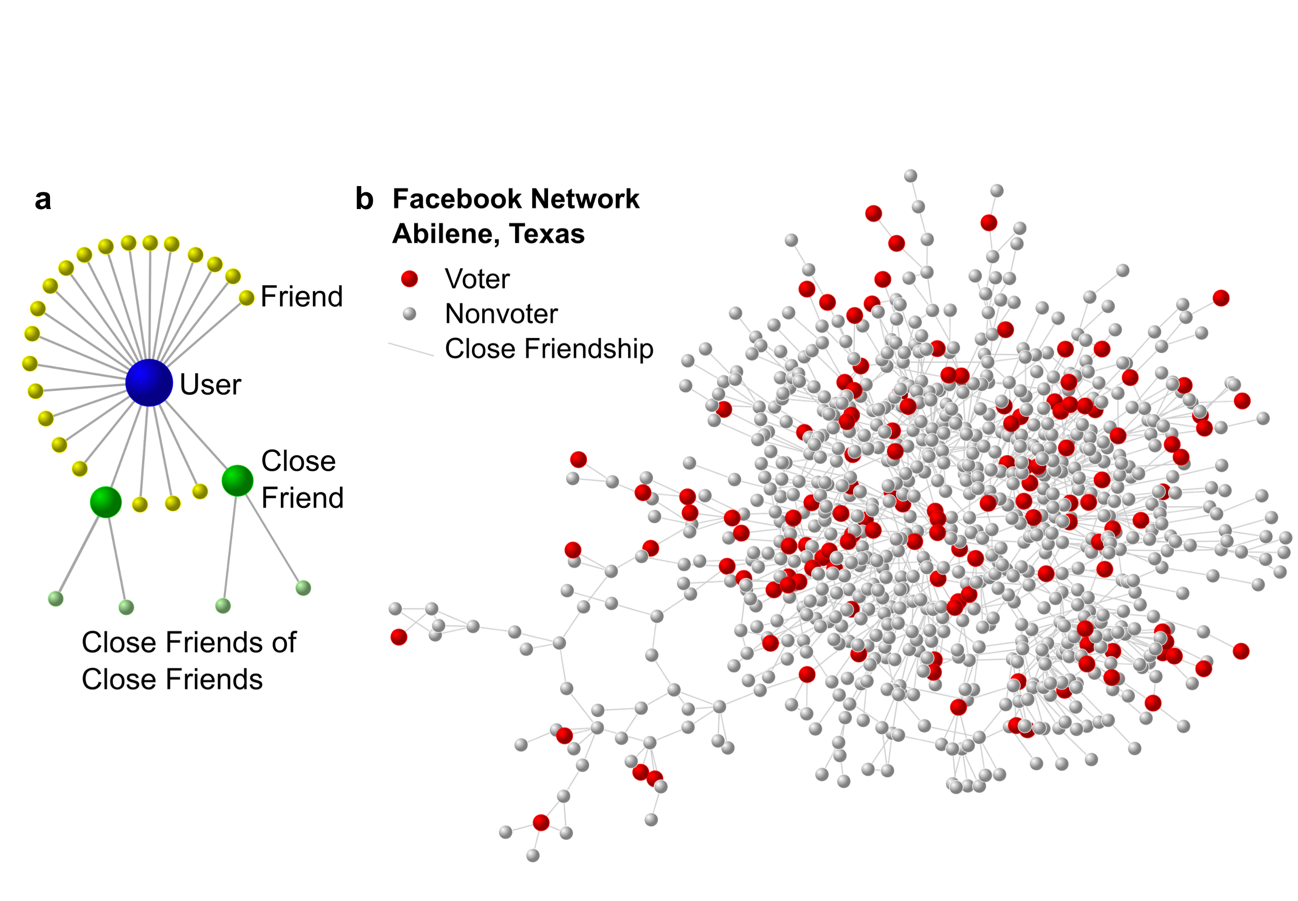

Slide 10
Command Line Interface
When you open R, you are greeted by a prompt:
>
As long as that character is showing and the cursor is blinking to the right of it, R is waiting for you to tell it what to do
Your output will be prefaced by an index for the line number, such as [1]
The # is the character you use to comment out your code

Slide 11
Commands
To get R to do anything, you must give it commands. Instead of a drop down menu of options, you enter the command at the command line

Slide 12
The Working Directory
This is where R is going to look to read files in, or export files out.
  Setting the working directory can be useful if you are doing lots of reading in and exporting out
  You can also do this manually

Slide 13
The Workspace
The “workspace” contains all of the objects you’ve created in a particular session of R that are floating around in R’s working memory
Save the workspace only if there are a large set of objects that you will always want to load all at once.

Slide 14
Objects
In R, all the things you create are called objects. To create an object, use the assignment operator:
<-
“Object” is a broad term for lots of things:
Dataset
Vector or matrix
x

Slide 15
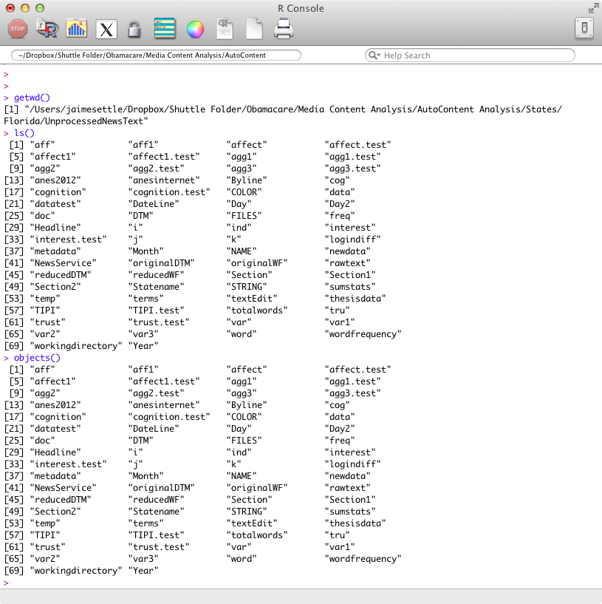
R shows you the working directory
There are all sorts of objects. Some are datasets, others are not.
ls() and objects() both ask R to show you what is in the workspace
The > and blinking cursor tell me R is ready for more

Slide 16
Datasets
You read in your data as an object:
  macro <- read.csv("macro.csv")
If you have previously saved your data in R’s format, you load your data
  load(file="macro.rda")
Your data will have rows and columns. Generally speaking, your rows are your cases and your columns are your variables.
  dim(macro)

Slide 17
Datasets, cont’d
Your dataset has variable names:
  names(macro)
You can identify a particular variable like this:
  macro$country
  macro[,1]
You can identify a particular row (case) like this:
  macro[,23]

Slide 18
But I want to see ALL the data?!?!
As a general rule, you don’t do this in R. Some of the R GUIs do have “data viewers” but in the command line interface there is no way to make your data appear in a nice, tidy, spreadsheet-like format

Slide 19
Instead, call selective parts
You can look at the values of a particular variable
You can look at a table of the values of a particular variable
You can call all the names in your dataset
You can look at the “head” or “tail” of your data
You can do “spot checks” by peeking at snapshots of your dataset
You can give R instructions with the criteria you want to view (which, length, order)

Slide 20
Let’s Try it Out!

